Slide 1
Modeling
CHOOSING THE MODEL, CHOOSING THE OBJECTIVE, FITTING THE MODEL
Sean Kang

Slide 2
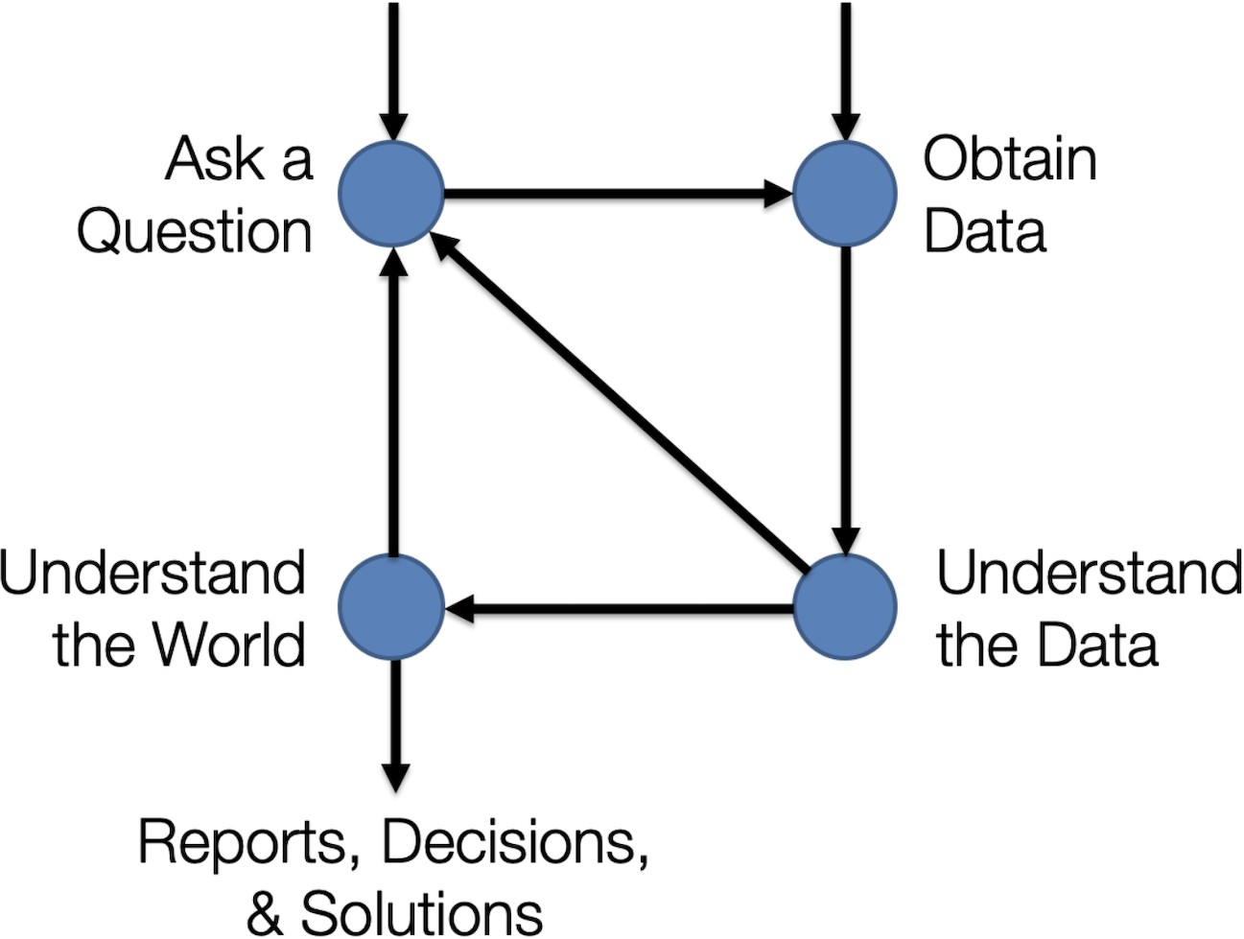
The Data Science Lifecycle

Slide 3
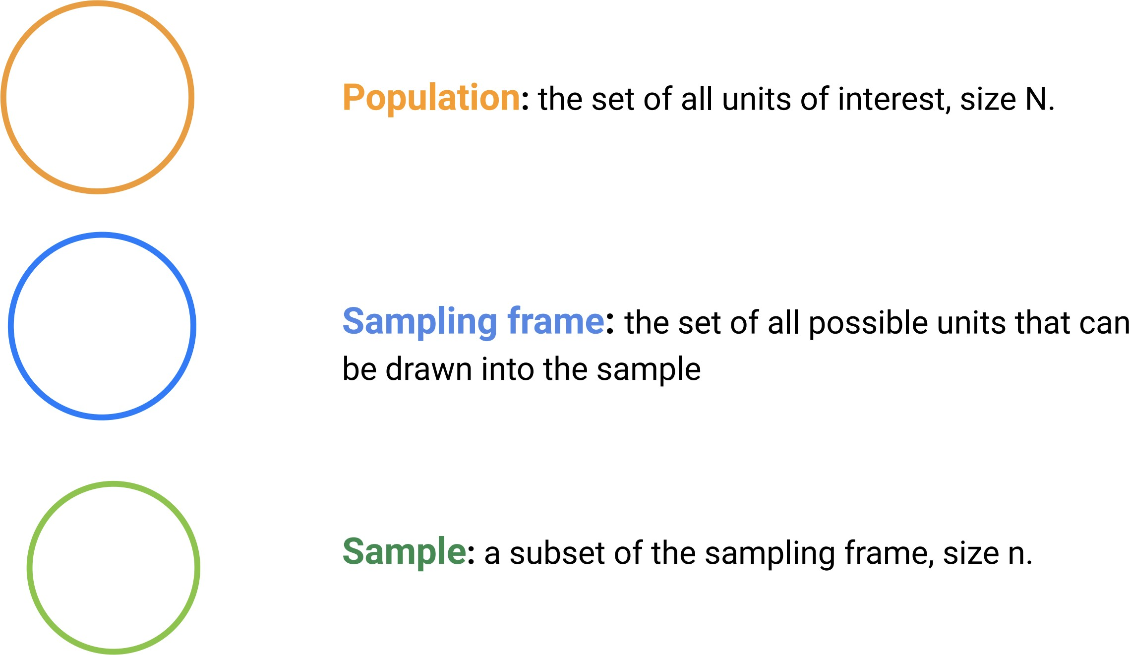
Sampling

Slide 4
Data Wrangling
Filtering rows Selecting columns Aggregation
Pivot Tables String methods
Regular expressions Joins

Slide 5
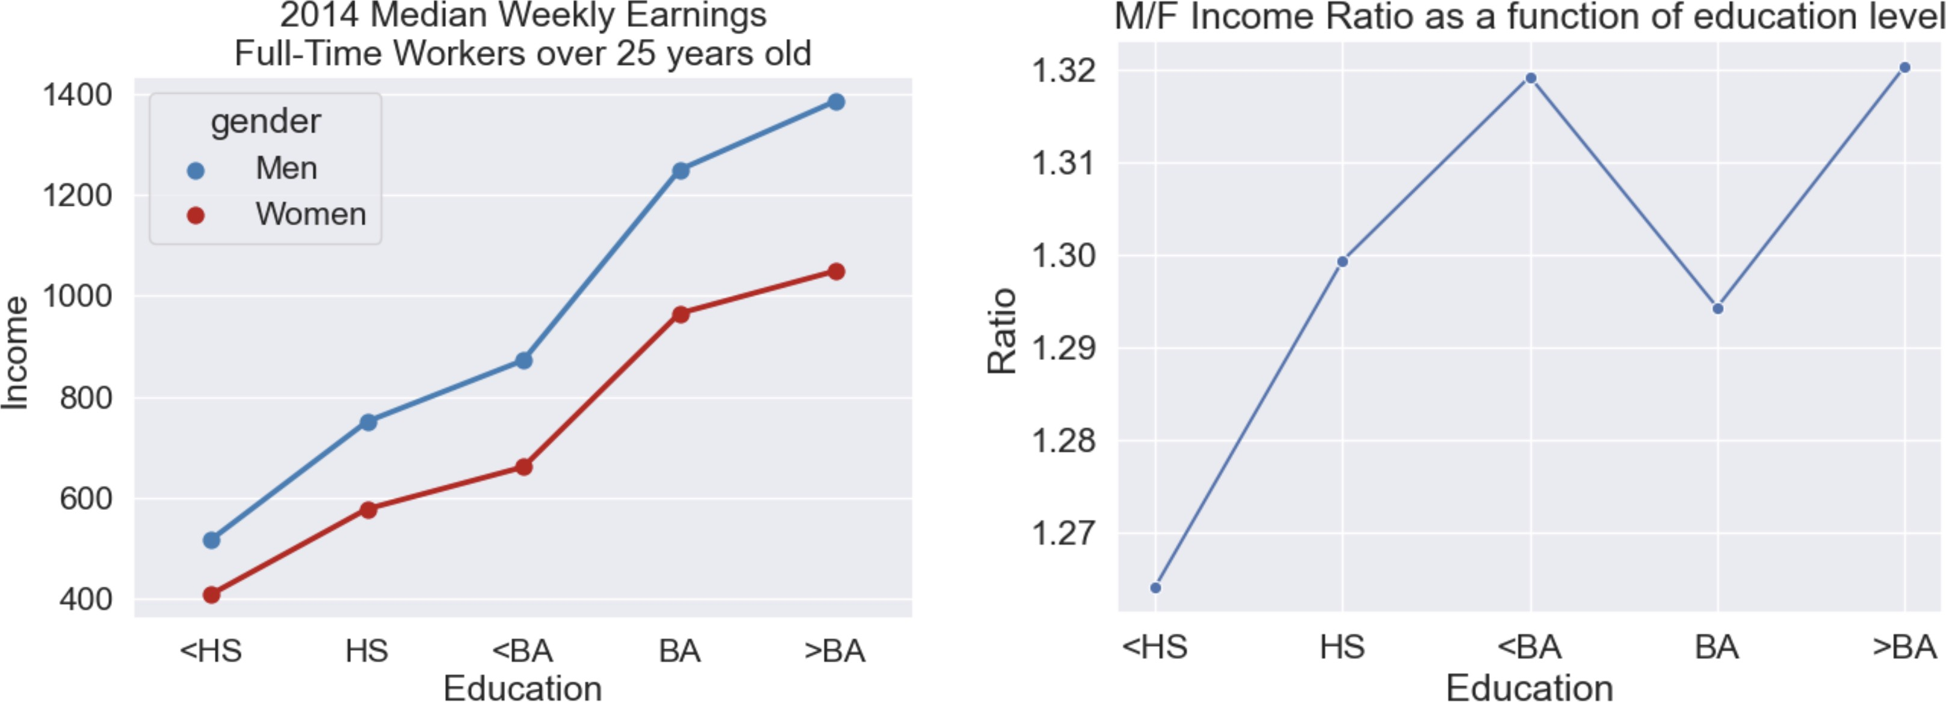
Data Visualization

Slide 6
1. Think about your Data
2. Think about your Model

Slide 7


What is a model?
De nition: A model is a useful simpli cation of reality.
We can model the fall of an object to earth as subject to a constant acceleration due to gravity at 9.81 m/s^2.
The model ignores:
local variation in gravity air resistance
non-linear dynamics in trajectory

Slide 8
How can a model be useful?
DESCRIPTION
To understand the world we live in.
What factors play a role in the spread of COVID- 19?
How do an object’s velocity and acceleration impact how far it travels?
PREDICTION
The predict the value of unseen data.
Is this email spam? Is this shape a pedestrian?

Slide 9
Two classes of models
PHYSICAL MODELS
Based upon well- established theories of how the world works.
STATISTICAL MODELS
Based upon observation and data.

Slide 10
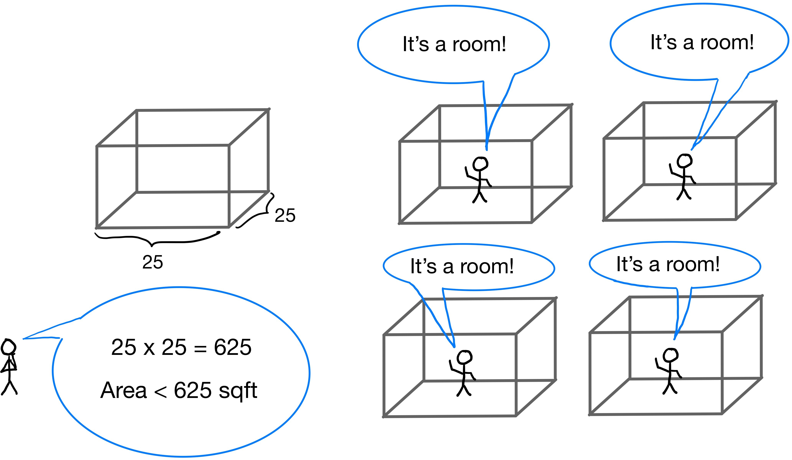
STATISTICAL MODEL
PHYSICAL MODEL

Slide 11
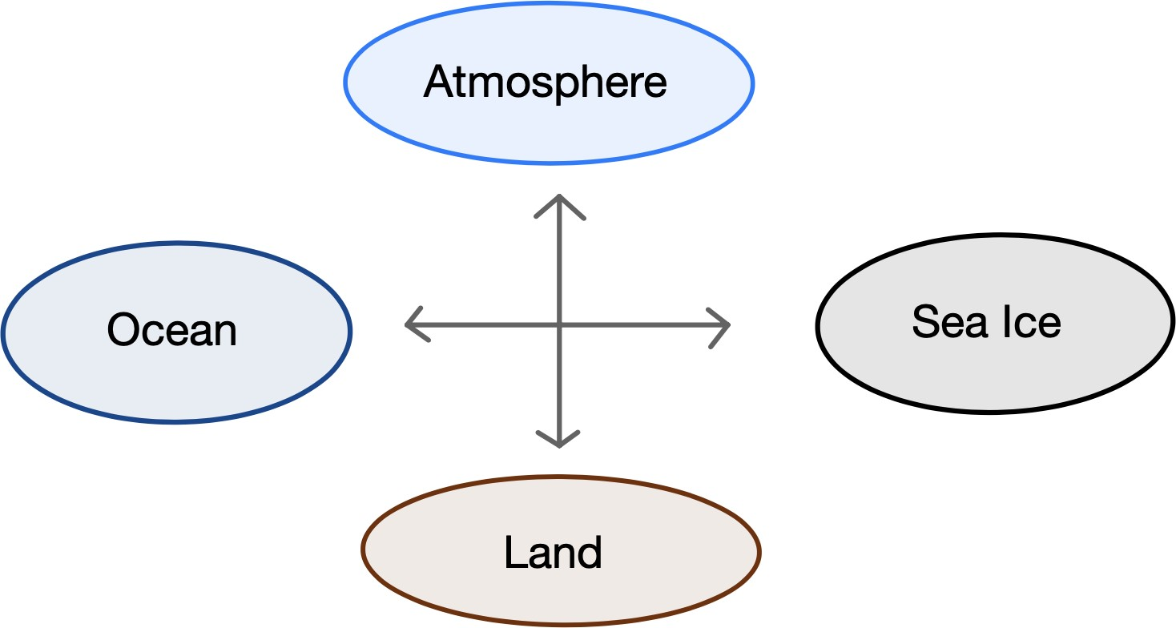

A physical model: GCM
Global Climate Model (GCM)

Slide 12
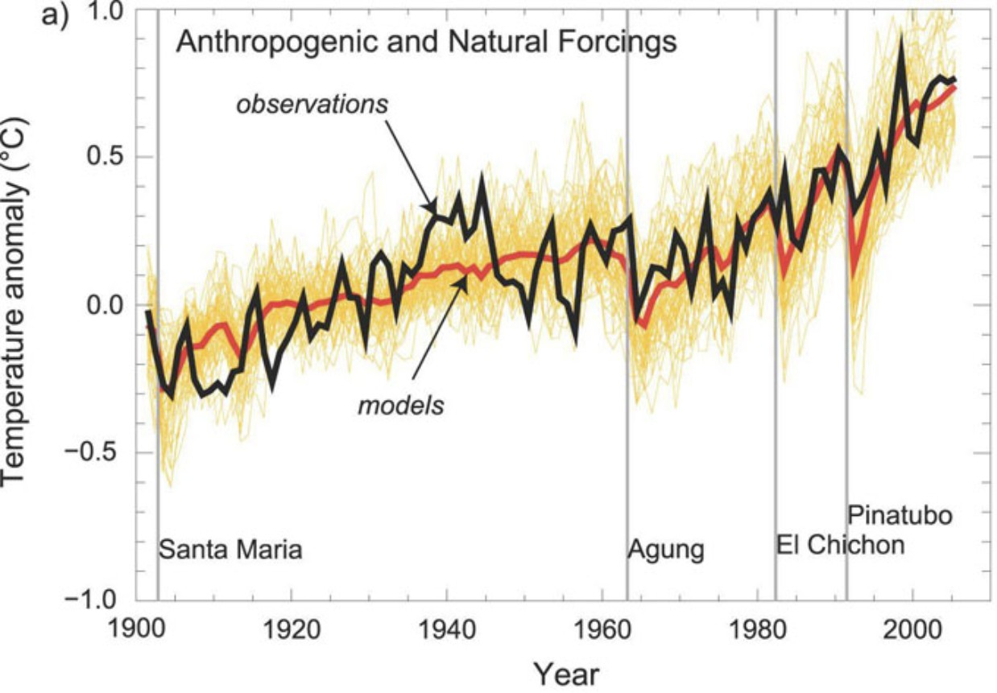
A physical model: GCM

Slide 13
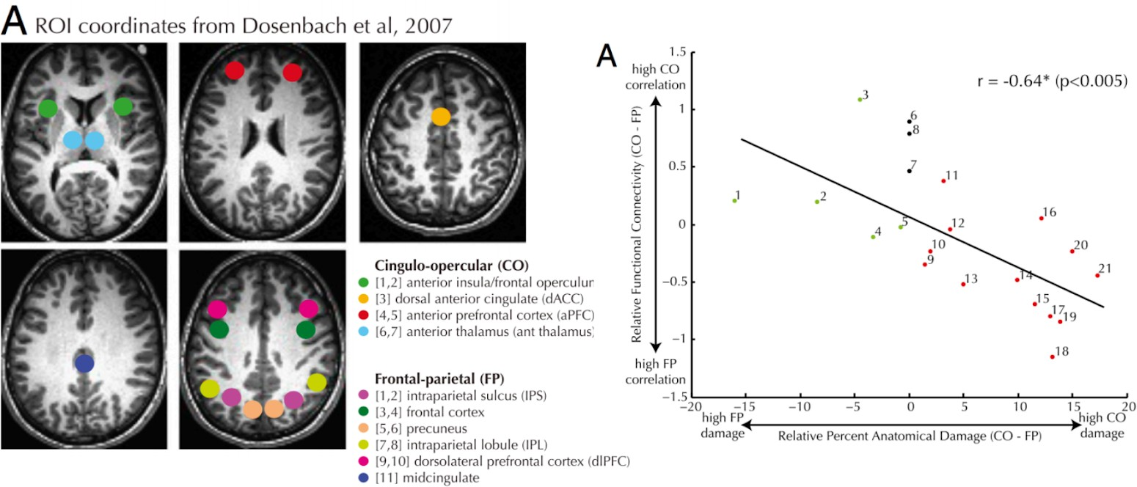
A statistical model: FMRI
Other times, we don’t have such a precise understanding of some natural relationship. In such cases, we collect data and use statistical tools to learn more about the relationships between variables.

Slide 14
Choosing the Model

Slide 15
The modeling process: 3 steps
CHOOSE A MODEL
CHOOSE AN OBJECTIVE FUNCTION
FIT THE MODEL BY OPTIMIZING YOUR OBJECTIVE FUNCTION

Slide 16

Choose a Model
Choose a simple model
A function with a constant.
A constant model predicts the same number regardless of the circumstances, ignoring all other information.
Example: Tips are 15%
Useful? Descriptive and predictive
Simple? Ignores bill price, time of day, customer type

Slide 17
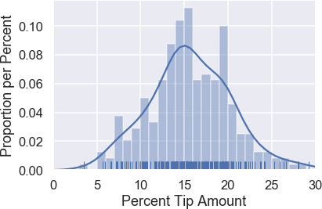
The Tips Dataset
Tip rate at a restaurant across 244 bills.
Which constant best models these tips?
15% seems better than 25%
Is 15% better than 14% We need a more precise formulation of this process.

Slide 18

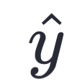


Notation
observations (data on tip %)
y_{i} individual observations
y₁, y₂, …, y_{n} data set of size n
Predicted observations (predicted tip %)
y₁ individual prediction
Model parameter(s) ( “true” constant tip %)
Fitted, or optimal, parameter(s) (est constant tip %)

Slide 19
Notation
The constant model can be stated as:
y^ = θ
Parameters define the model
Some models are nonparametric (e.g. KDEs) A constant model ignores any input
Models can have many parameters
1
y^ = θ₀ + θ₁x
y^ =
1 + exp(−x^{T} θ)
Goal: find "best" value of the parameter, denoted θ^

Slide 20
Estimation
Prediction
Using the fitted model parameters to predict outputs for unseen data
Using data to determine model parameters
θ^ = f₁(y, x)
^
y^_{i} = f₂(θ, x_{i})

Slide 21
The modeling process: 3 steps
CHOOSE A MODEL
Constant model Linear model Non-linear model
CHOOSE AN OBJECTIVE FUNCTION
Prediction: Loss function Description: e.g. Likelihood function
FIT THE MODEL BY OPTIMIZING YOUR OBJECTIVE FUNCTION
Analytical approach (calculus, algebra)
Numerical approach (optimization, gradient descent)

Slide 22
Loss functions

Slide 23
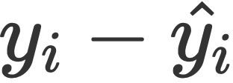
The cost of doing business (making predictions)
We need some metric of how “good” or “bad” our predictions are. This is what loss functions provide us with. Loss functions quantify how bad a prediction is for a single observation.
If our prediction is close to the actual value, we want low loss.
If our prediction is far from the actual value, we want high loss.
A natural choice of loss function is actual - predicted, or single prediction.
. We call this the error for a
But, this treats “negative” predictions and “positive” predictions differently.
Predicting 16 when the true value is 15 should be penalized the same as predicting 14.
This leads to two natural loss functions.

Slide 24
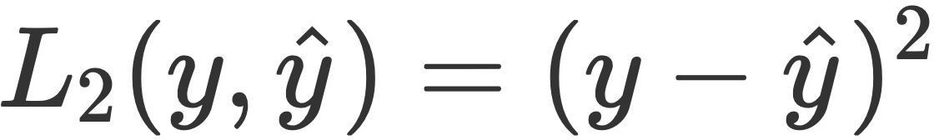
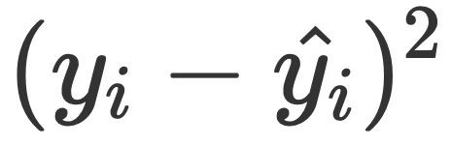
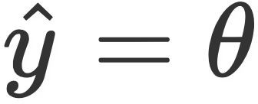
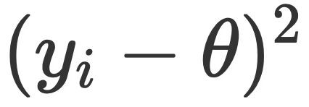
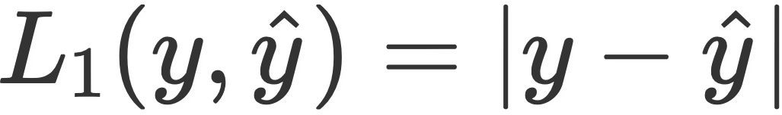
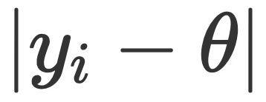
Squared and absolute loss
The most common loss function you’ll see is the squared loss, also known as L2 loss.
If our prediction is equal to the actual observation, in both cases, our loss is 0.
Low loss means a good fit!
For a single data point in general, this is
For our constant model, since , this is
.
.
Another common loss function is the absolute loss, also known as L1 loss.
For our constant model, for a single point, this is .
There are benefits and drawbacks to both of the above loss functions. We will examine those shortly. These are also not the only possible loss functions; we will see more later.

Slide 25

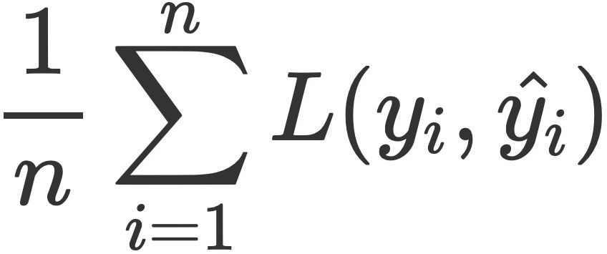
Loss functions and empirical risk
We care about how bad our model’s predictions are for our entire data set, not just for one point. A natural measure, then, is of the average loss across all points. Assumin points:
g
Other names for average loss include empirical risk and an objective function.
The average loss of a model tells us how well it fits the given data. If our model has a low average loss across our dataset, that means it is good at making predictions. As such, we want to find the parameter(s) that minimize average loss, in order to make our model as good at making predictions as it can be.

Slide 26
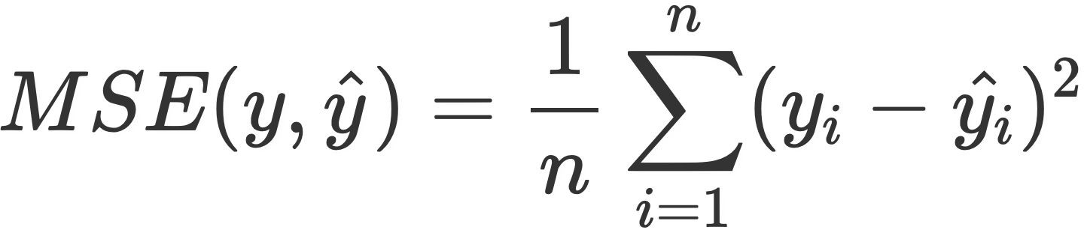
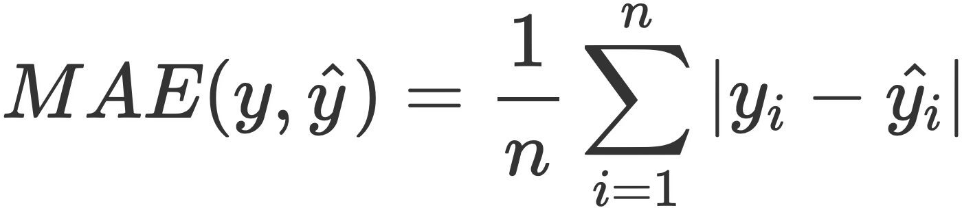
MSE and MAE
If we choose squared loss as our loss function, then average squared loss is typically referred to as mean squared error (MSE), and is of the following form:
If we choose absolute loss as our loss function, then average absolute loss is typically referred to as mean absolute error (MAE), and is of the following form:
These definitions hold true, regardless of our model. We want to minimize these quantities.

Slide 27


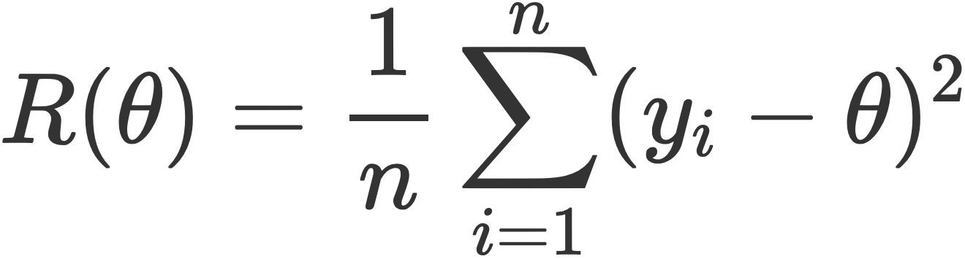
Exploring MSE
Average loss is typically written as a function of , since defines what our model is (and hence what our predictions are). For example, with squared loss and the constant model, our average loss (and hence, the function we want to minimize) is
Average loss is also a function of our data. But unlike theta, we can’t change our data: it is given to us (i.e. it is fixed).

Slide 28
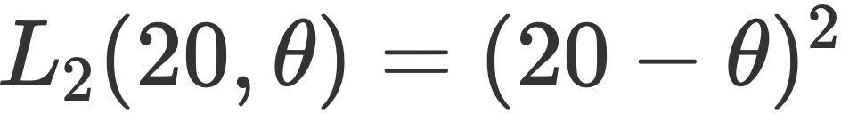
Exploring MSE
When our model is the constant model, and we choose to use L2 loss, again, our average loss looks like:
Let’s examine a toy example. Suppose we have 5 observations, [20, 21, 22, 29, 33].
The loss for the first observation (y₁).
The average loss across all observations (the MSE).

Slide 29
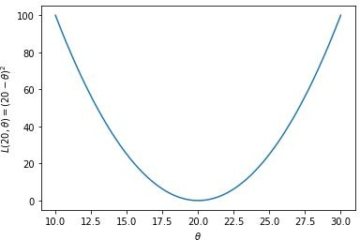
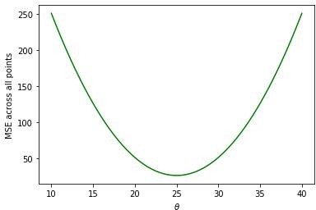
Exploring MSE
The loss for the first observation (y₁).
The average loss across all observations (the MSE).
A parabola, minimized at theta = 20.
Also a parabola! Minimized at theta = 25.

Slide 30
Minimizing mean squared error (MSE)
for the constant model

Slide 31
Minimizing MSE
We saw with the toy example of [20, 21, 22, 29, 33] that the value that minimizes the MSE of the constant model was 25, which was the mean of our observations.
We can try other examples if we want to, and we’ll end up with the same result. It can be proven using mathematics. There are two ways we’ll go about doing this:
Using calculus.
Using algebraic approach.

Slide 32
Minimizing mean absolute error (MAE)
for the constant model

Slide 33
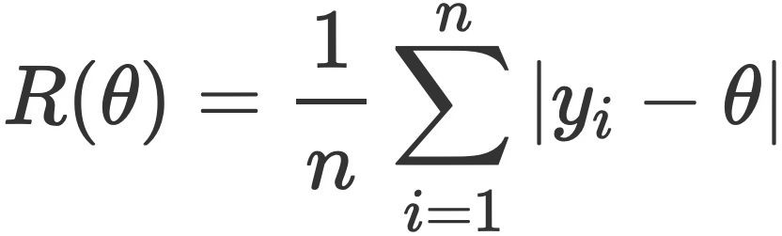

Exploring MAE
When we use absolute (or L1) loss, we call the average loss mean absolute error. For the constant model, our MAE looks like:
Let’s again re-visit our toy example of 5 observations, [20, 21, 22, 29, 33].
The loss for the first observation (y₁).
The average loss across all observations (the MAE).

Slide 34
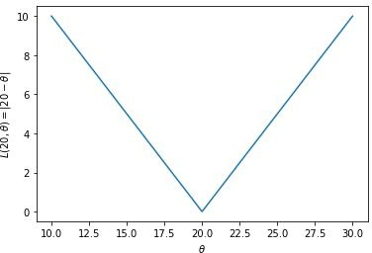
Exploring MAE
The loss for the first observation (y₁).
The average loss across all observations (the MAE).
An absolute value curve, centered at theta = 20.

Slide 35
Comparing loss functions

Slide 36
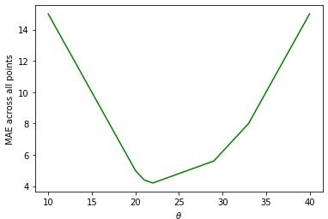
MSE vs. MAE
What else is different about squared loss (MSE) and absolute loss (MAE)?
Mean squared error (optimal parameter for the constant model is the sample mean)
Very smooth. Easy to minimize using numerical methods (coming later in the course).
Very sensitive to outliers, e.g. if we added 1000 to our largest observation, the optimal theta would become 225 instead of 25.
Mean absolute error (optimal parameter for the constant model is the sample median)
Not as smooth – at each of the “kinks,” it’s not differentiable. Harder to minimize.
Robust to outliers! E.g, adding 1000 to our largest observation doesn’t change the median.
It’s not clear that one is “better” than the other. In practice, we get to choose our loss function!

Slide 37
The modeling process
We’ve implicitly introduced this three-step process, which we will use constantly throughout the rest of the course.
Choose a model
Choose a loss function
Fit the model by minimizing average loss

Slide 38
The modeling process
We’ve implicitly introduced this three-step process, which we will use constantly throughout the rest of the course.
Choose a model
In this lecture, we focused exclusively on the constant model, which has a single parameter.
Choose a loss function
Parameters define our model. They tell us the relationship between the variables involved in our model. (Not all models have parameters, though!)
Fit the model by minimizing average loss
In the coming lectures, we will look at more sophisticated models.

Slide 39
The modeling process
We’ve implicitly introduced this three-step process, which we will use constantly throughout the rest of the course.
Choose a model
We introduced two loss functions here: L2 (squared) loss and L1 (absolute) loss. There also exist others.
Choose a loss function
Both have their benefits and drawbacks. We get to choose which loss function we use, for any modeling task.
Fit the model by minimizing average loss

Slide 40
The modeling process
We’ve implicitly introduced this three-step process, which we will use constantly throughout the rest of the course.
Choose a model
Lastly, we choose the optimal parameters by determining the parameters that minimize average loss across our entire dataset.
Different loss functions lead to different optimal parameters.
Choose a loss function
This process is called fitting the model to the data. We did it by hand here, but in the future we will rely on computerized techniques.
Fit the model by minimizing average loss

Slide 41
Summary

Slide 42
Vocabulary review
When we use squared (L2) loss as our loss function, the average loss across our dataset is called mean squared error.
“Squared loss” and “mean squared error” are not the exact same thing – one is for a single observation, and one is for an entire dataset.
But they are closely related.
A similar relationship holds true between absolute (L1) loss and mean absolute error.
Loss functions and summary statistics you already knew:
The sample mean is the value of that minimizes the mean squared error.
The sample median is the value of that minimizes the mean absolute error.
“Average loss” and “empirical risk” mean the same thing for our purposes.
So far, our empirical risk was either mean squared error, or mean absolute error.
But generally, average loss / empirical risk could be the mean of any loss function across our dataset.

Slide 43
What’s next...
Changing the model.
Next, we’ll introduce the simple linear regression model that you saw in Data 8.
We’ll also look at multiple regression, logistic regression, decision trees, and random forests, all of which are different types of models.
Changing the loss function.
L2 loss (and, hence, mean squared error) will appear a lot.
But we’ll also introduce new loss functions, like cross-entropy loss.
Changing how we fit the model to the data.
We did this largely by hand in this lecture.
But shortly, we’ll run into combinations of models and loss functions for which the optimal parameters can’t be determined by hand.
As such, we’ll learn about techniques like gradient descent.

